Slide 1


6.2 Online Job Search

Slide 2
Objectives
Objectives
Identify the steps for an effective job search
Evaluate career interests and abilities
Research job market
Discuss the impact of technology on the job search
Evaluate job search engine strategies
Complete sample online application

Slide 3
Getting Started
What are reasons for a job search?
How did you (or someone you know) get a job in the past?
How has the internet changed the job hunt process?

Slide 4
What does a modern job hunter need?

Slide 5
Internet Access
1. Internet Access

Slide 6

Professional Email Address
2. Professional Email Address

Slide 7

Resume
3. Resume

Slide 8
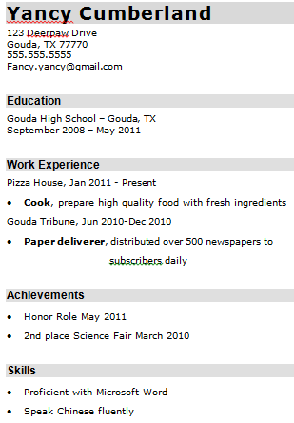
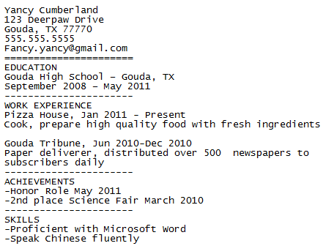
Plain Text Example
MS Word/PDF
Plain Text

Slide 9

Organizational System
4. Organizational System

Slide 10
Time
5. Time

Slide 11
Positive Attitude
6. Positive Attitude

Slide 12

Networking
A network includes:
Family
Friends
Recreational groups
Church and social organizations
Former teachers and classmates
Current and former co-workers

Slide 13

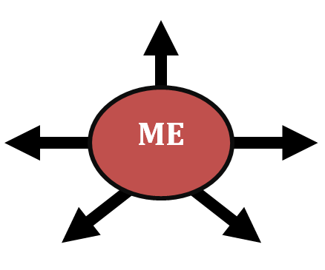




Who is in your Network
Who is in your network?

Slide 14
Grow Your Network
Make others aware of your career goals
Professional organizations
Attend Conferences and Job Fairs
Contact companies directly
Volunteer/Intern
Freelance work

Slide 15



Grow Your Network
Social media (Facebook/LinkedIn/Twitter)
Personal Blog/website
Email

Slide 16
The Five Steps

Slide 17
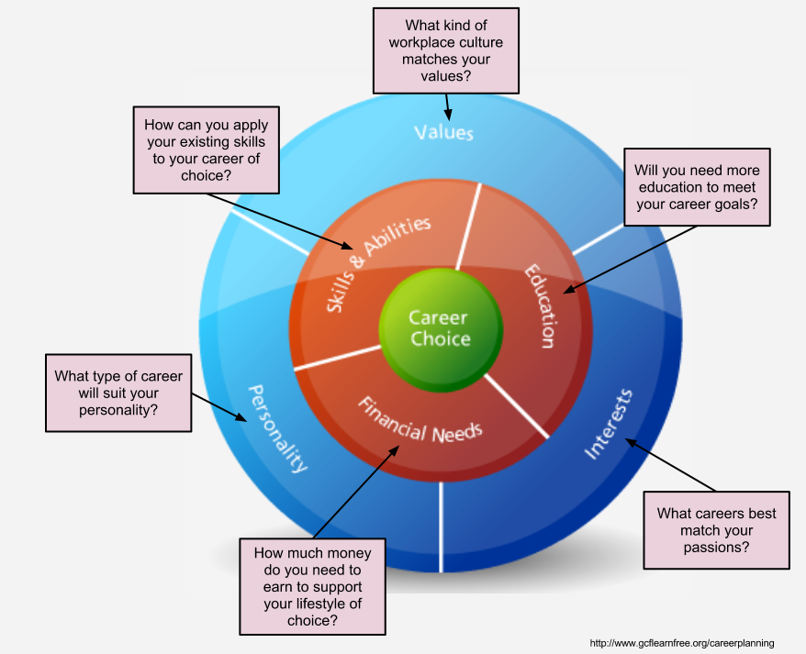
Self Assessment
1. Self Assessment

Slide 18
2. Research
Q. What is the state of the industry?
Q. What kinds of positions are available?
Q. What are the working conditions/culture like?
Q. What are the educational requirements?
Q. What is the average salary?

Slide 19
3. Career Objective
Skills
Sacrifices
Network
Physical stuff

Slide 20
4. Find Job Openings
NETWORK!
(70% of jobs)

Slide 21




Online Job Boards
Online Job Boards:

Slide 22
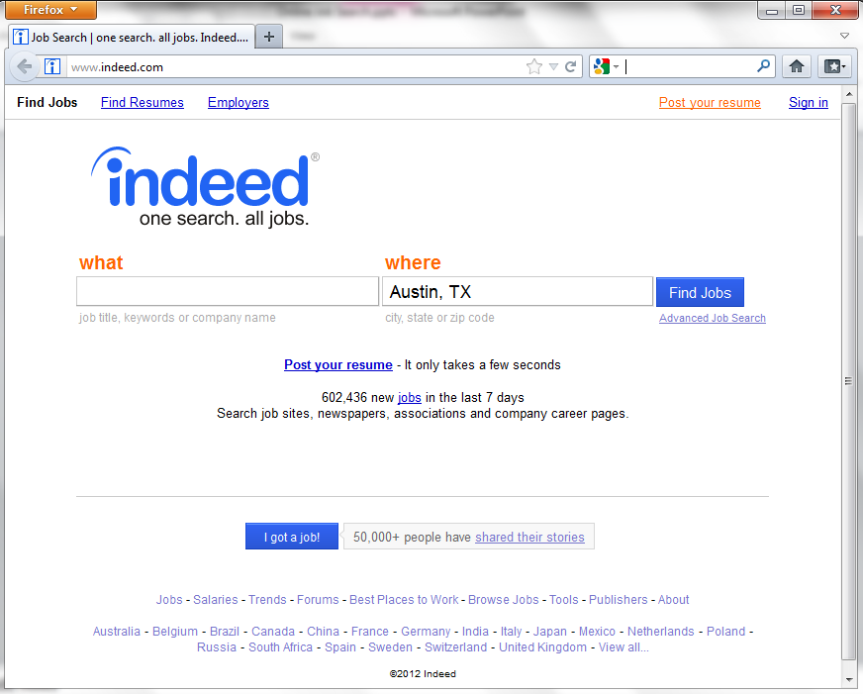
Indeed
Click here to see the search results
Type in a job, company, or career field here
Type in the city, state, or zip code here

Slide 23
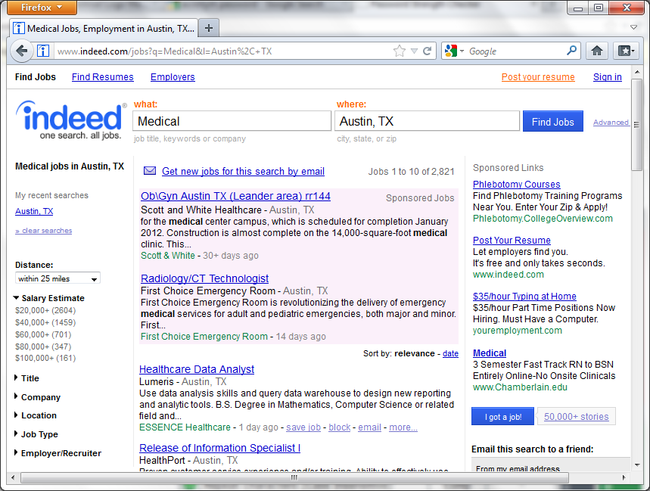
Indeed

Slide 24
Online Job Boards
Online Job Boards: more than browsing for jobs.
Email job alerts
Post resume
Career research resources

Slide 25
Online Job Boards
Online Job Boards: more than browsing for jobs.
Email job alerts
Post resume
Career research resources

Slide 26
ExperienceWorks Website Link
http://www.experienceworks.org/site/PageServer?pagename=Practice_Online_application

Slide 27
5. Follow-up
Talk to someone at the company to make a connection (networking)
Show interest in position
Record in Job Search Journal

